Slide 1
Making of Paper in Bangladesh and other country

Slide 2
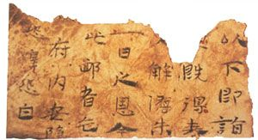
Invention
Why paper was invented ?
Where it was first invented ?
Who invented it first ?
Paper of 105AD

Slide 3
Making process of paper in different country
In china
Linen,flax,hemp
In Arab
Flax,vegetable fibre
In India
Bamboo,pulp

Slide 4
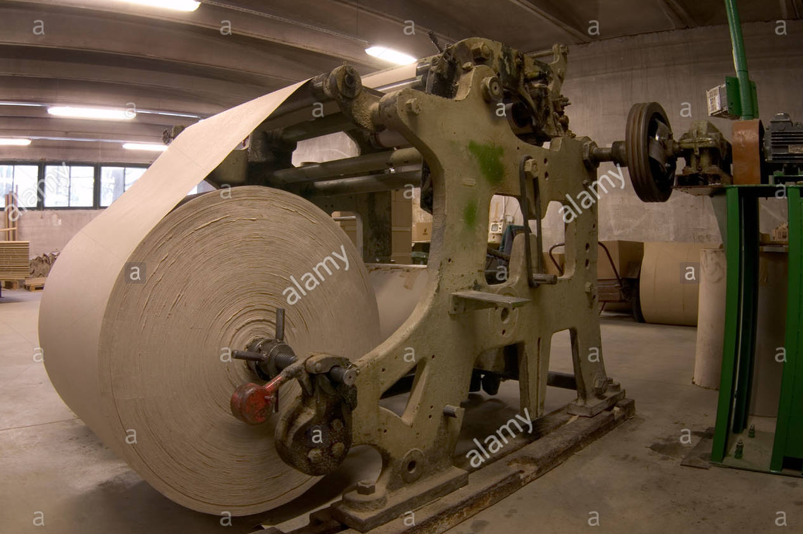
Paper in Bangladesh
Three state owned paper mill
Karnaphuli paper mill
Khulna newsprint mill
Pakshi north Bengal paper mill
Private mills and Their production capacity

Slide 5
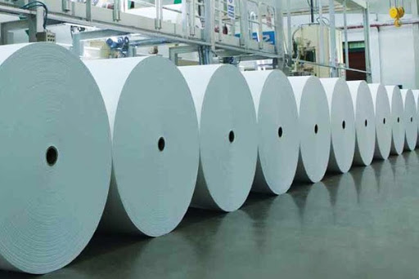
Role of paper in our national economy
Private mills in economy
state-owned mills in economy

